Slide 1


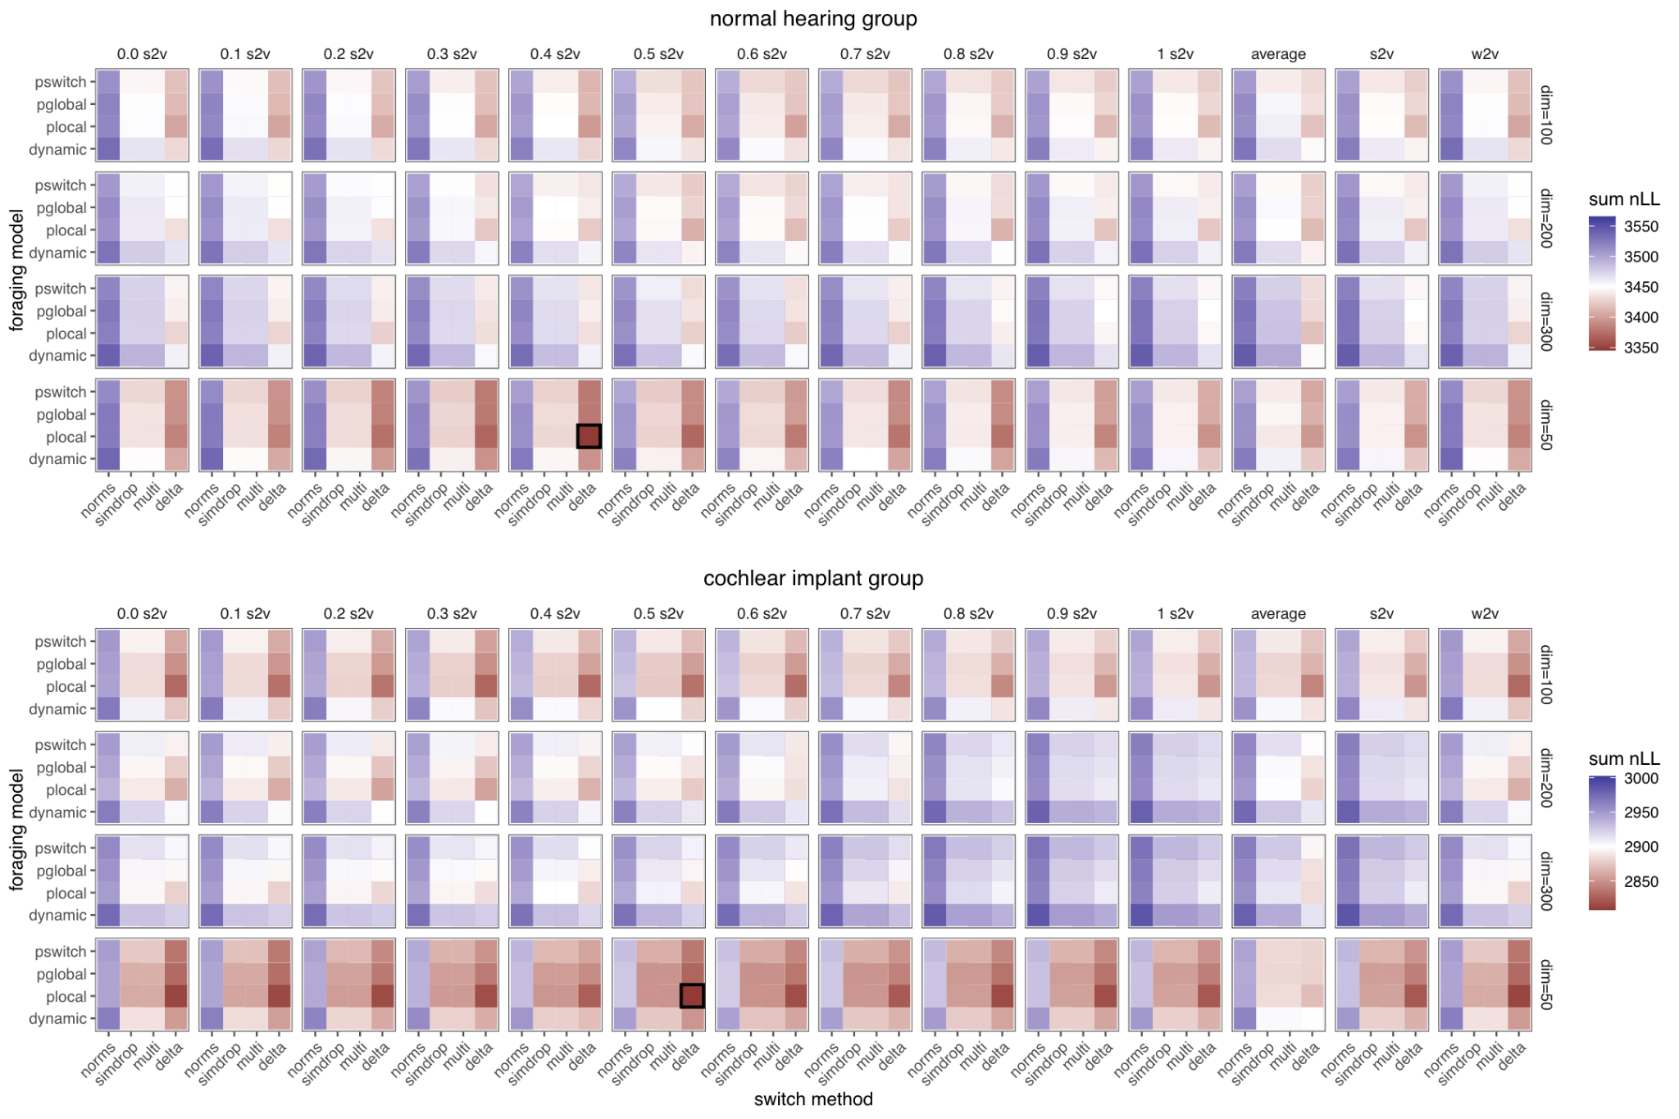
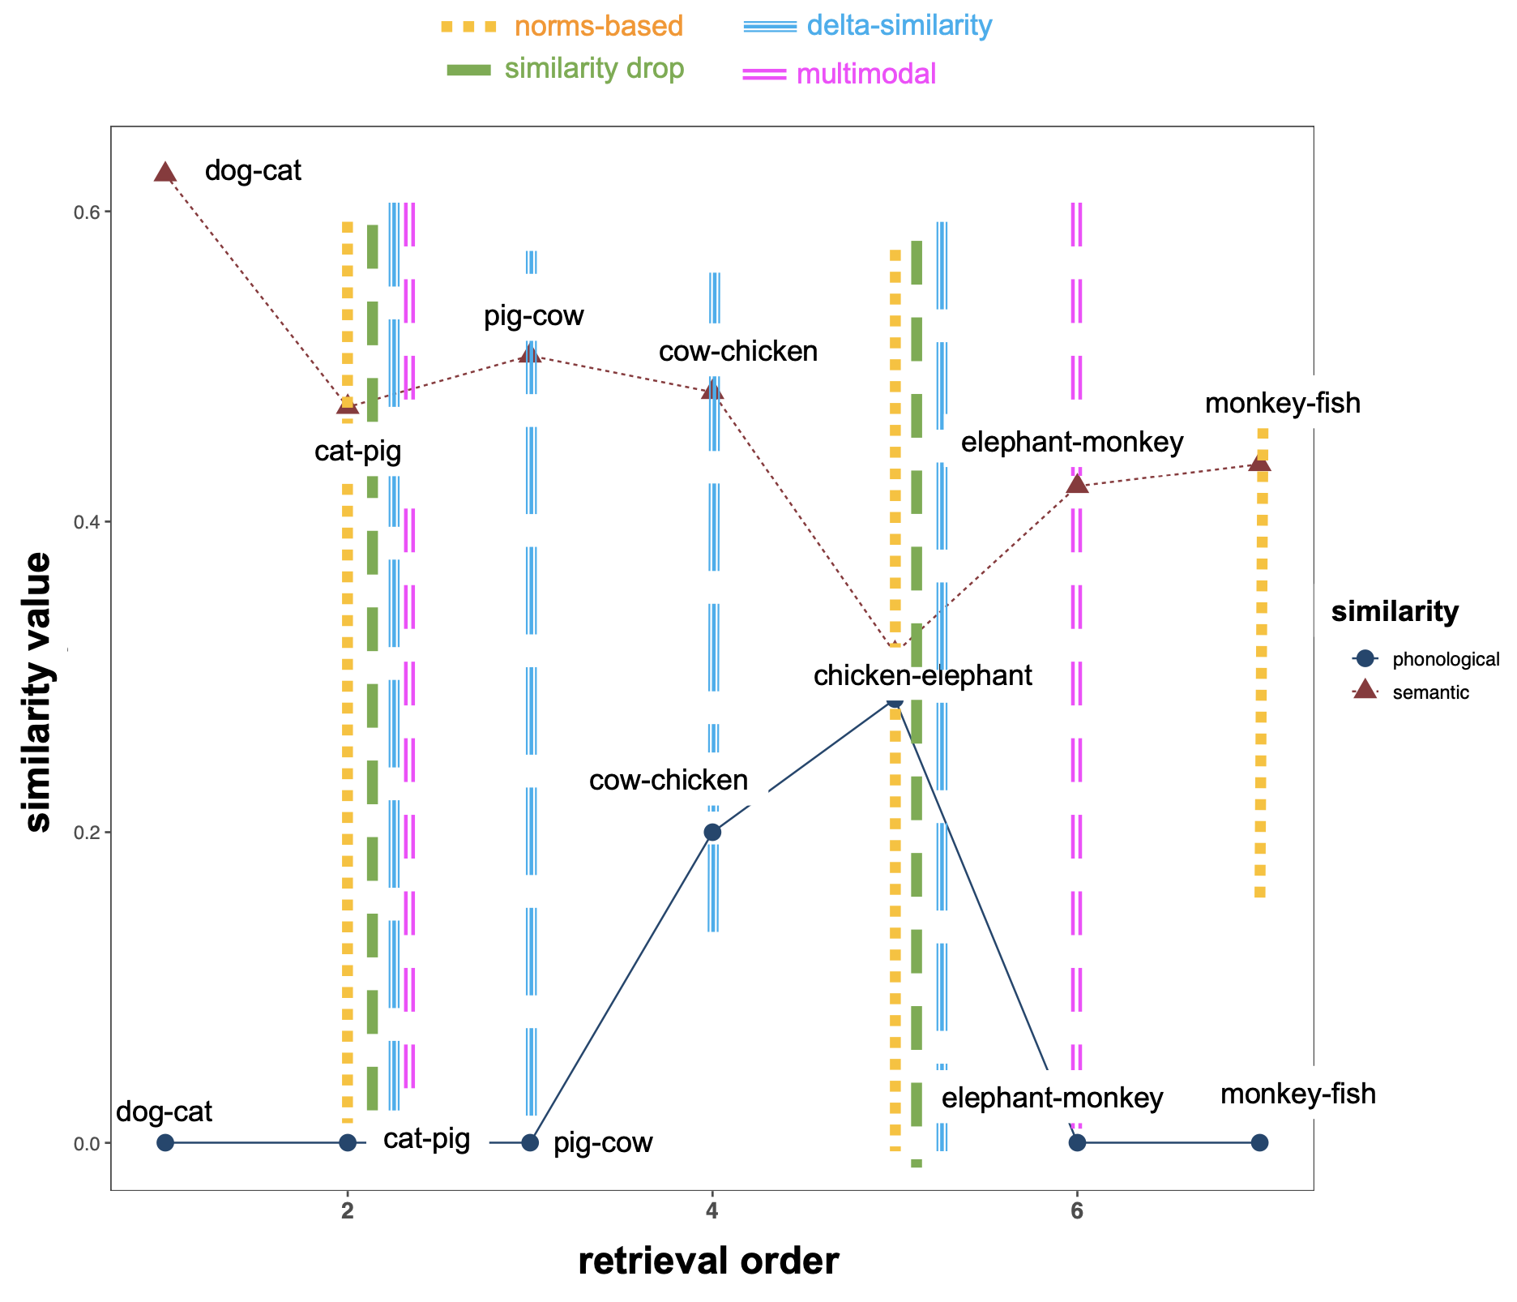
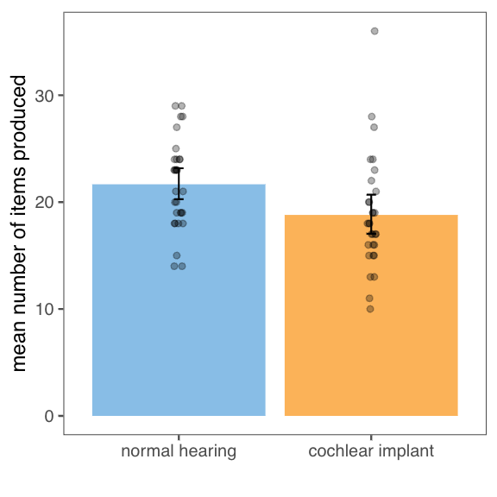
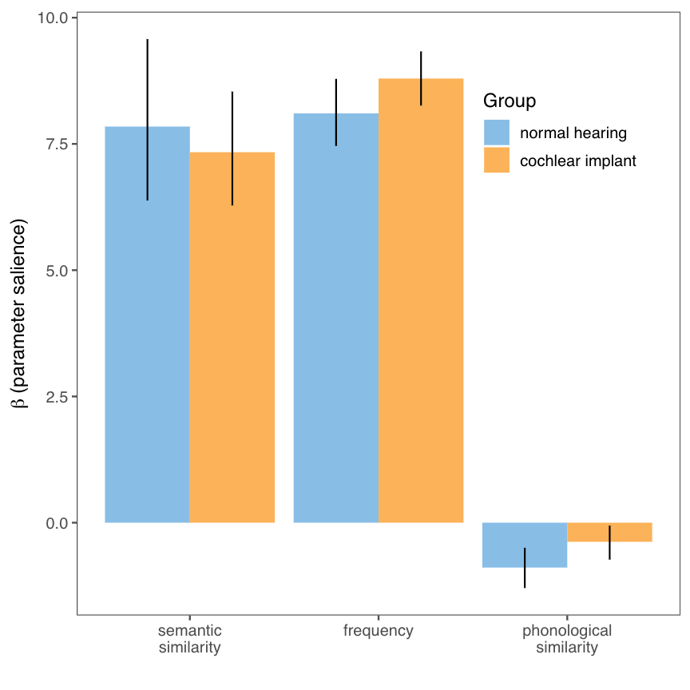
Convolutional Nearest Neighbor
Mingi Kang, Jeova Farias Sales Rocha Neto PhD.
Bowdoin College, ME
INTRODUCTION
EXPERIMENTAL RESULTS
Individuals with cochlear implants (CIs) and normal hearing (NH) engage in “clustering and switching” during memory search, similar to optimal foraging in the wild.
Semantic and phonological cues influence memory search differently in individuals with cochlear implants (CIs) compared to normal hearing (NH).
We investigated search in prelingually deaf individuals with CIs to explore the impact of early phonological input on semantic organization and retrieval processes.
BASE ALGORITHM
Structural models:
Embeddings with lower dimensions provided a better fit than models with higher dimensions.
The concatenated variants of speech2vec and word2vec performed better than the single-model or the “average” model.
For normal hearing group, the best-performing structural model emphasized word2vec over speech2vec (𝛼 = 0.4).
For cochlear implant group, the best-performing structural model emphasized speech2vec and word2vec equally (𝛼 = 0.5).
Process models:
Best-performing process model was the dynamic foraging model that incorporated semantic similarity, phonological similarity, and frequency in local “cluster” transitions and frequency in global “switch” transitions, and used the delta similarity method to assign cluster-switch designations.
LOCALITY AND SPARSITY
example: dog - cat - pig - cow - chicken - elephant - monkey - fish
LEXICAL SOURCES / FLUENCY PERFORMANCE
PARTICIPANTS
CIs attend more to frequency than NHs, no differences in use of semantic similarity
Both groups appear to use phonology for local within-cluster transitions (based on best-performing models)
Variable | Mean (Range) in CIs (N = 30) | Mean (Range) in NHs (N=30)
Chronological age (Years) | 15.74 (9.86-26.66) | 16.18 (10.2-27.07)
Age at implementation (months) | 37.94 (11.07-75.76) | -
Duration of CI use (Years) | 12.58 (7.79-21.19) | -
Age of onset of deafness (months) | 2.41 (0-24) | -
Standardized PPVT-5* | 84.69 (42-123) | 108.63 (79-132)
DISCUSSION
CIs and NHs WERE SENSITIVE TO REPRESENTATIONS DERIVED FROM TEXT AND SPEECH
The lexicon is most likely represented in a multimodal format across both groups.
CIs EQUALLY EMPHASIZED REPRESENTATIONS DERIVED FROM SPEECH & TEXT, NHs DE-EMPHASIZED SPEECH IN FAVOR OF TEXT
Among neurotypical individuals, speech-related cues may be overtaken by textual or linguistic cues over time, whereas CIs may rely on these cues a lot more than their peers.
Note: PPVT-5 stands for the Peabody Picture Vocabulary Test, a standardized test that measures receptive vocabulary knowledge
REFERENCES
REFERENCES

